Slide 1
IE 7215 Simulation Analysis
PUBG system
Team members：
Jiacheng Ying
Yueqi Shen
Kuangyu Jin
Hanzhang Xiong

Slide 2


Slide 3
Project Overview
01. Introduction about the PUBG system
02. Programming
01
02
PUBG system
05
03
03. Input and output
Optimization
04
04. Simulation verification by Arena

Slide 4
Introduction about the PUBG system
What is PUBG
1
PUBG is a tactical competitive shooting sandbox game developed by blue hole. In this game, players collect various resources on the game map and fight other players in a shrinking safe area to keep themselves alive to the end.
Problems & Requirements
How to determine the amount of time each player needs to wait in line at a certain system capacity by the number of players, the duration of the game, and the game mode.
2
Approaches
3
The questionnaire survey is used to calculate the time each player may play in the system Then the simulation queuing program is used to simulate the approximate queuing time required by the player. Finally, the queuing time is used to adjust the capacity of the entire system.
System Goals
While determining the service capacity of the entire system allows the player to play the game smoothly, the game company can also save as much money as possible to maintain and operate the game.
4

Slide 5
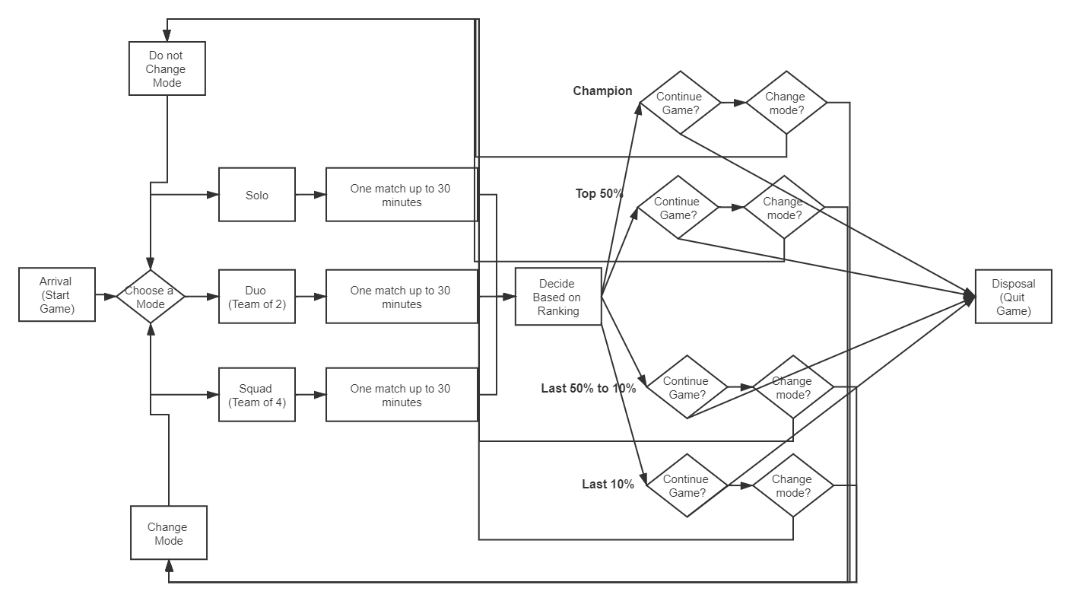
Programming
The main idea
We started off with an NSPP (non-stationary Poisson Process) to generate the players, and then split them through three paths (Single row, double row and four row modes), then we calculated the time spent on each path, and calculate the service number.

Slide 6
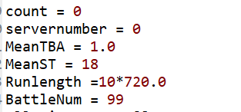
Programming
Factors that affect the number of servers we estimate
1. Time per game and total number of players per game

Slide 7
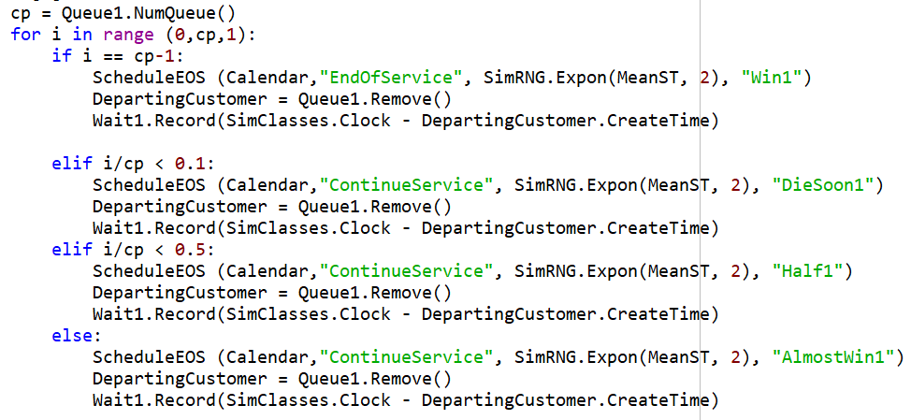
Programming
Factors that affect the number of servers we estimate
2. The player's position and the performance in each game, and the probability of entering the next game.

Slide 8
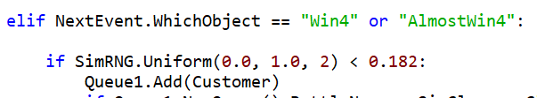
Programming
Factors that affect the number of servers we estimate
3. The probability that the player moves to the next game in different modes.

Slide 9
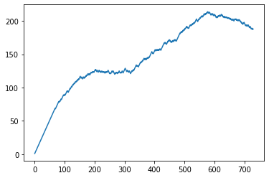
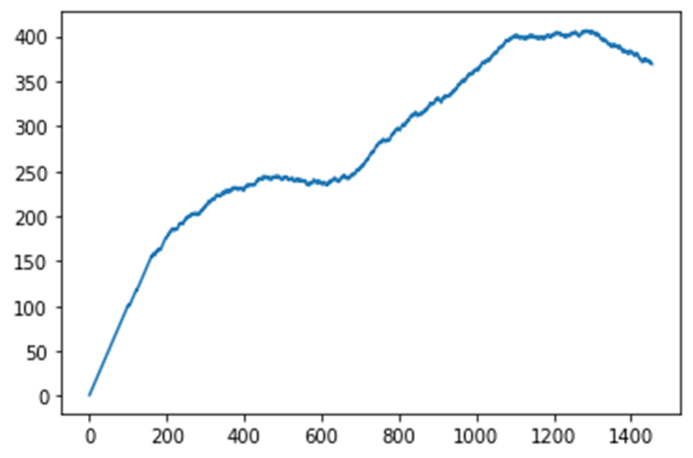
Programming
Factors that affect the number of servers we estimate
Servers number in the game system (more players per game, less server).
The number of servers changes with 200 players per game
The number of servers changes with 100 players per game

Slide 10
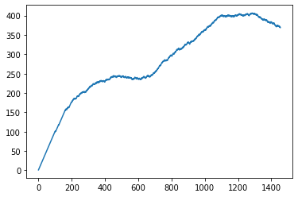
Programming
As the number of players increases, the server increases as shown.

Slide 11
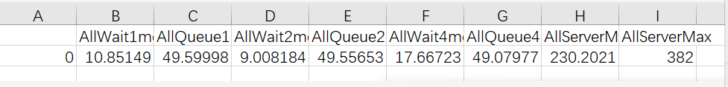
Programming
This is the result of the each mean an all wait time of the one person queue, double queue channel and four queue cannel when the mean server number is 230 and max server number is 382.

Slide 12
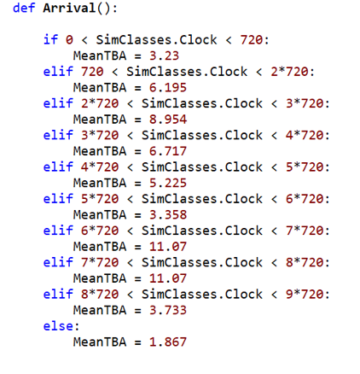
Input and output
Distribution of Input model
This input model follow the non-stationary Poisson Process.
The number of players entering the game varies from time to time, such as the picture.

Slide 13

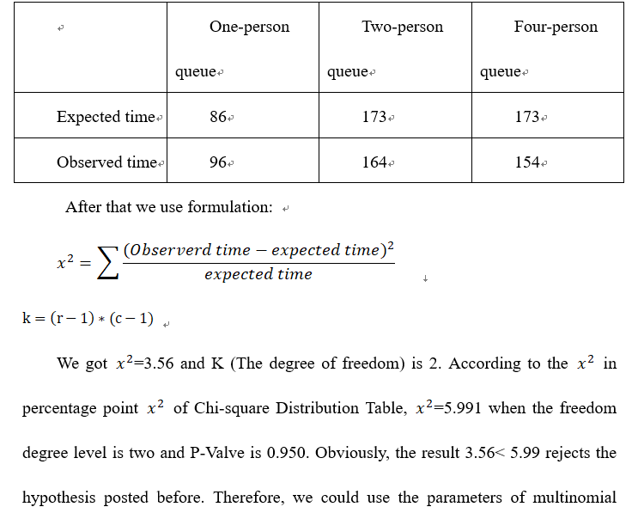

Input and output
Distribution of Input model
In the following part, the details are showed below:
2.Ranking Part: There will be several ranking levels between players, however, they won’t change the number of the server and make the function to the simulation. Therefore, we assume that server number in this position:
3. Re-Play Desire: Similarly, we assume that
1. Modeling sort: We using Chi-Square test the real-word data(survey) with official number and get fitted to the multinomial distribution
The distribution of random Q could be estimated by using data
with i= 1,2, …, m for four different ranking level. After using bootstrap, we are able to assume Q follows Uniform distribution,

Slide 14
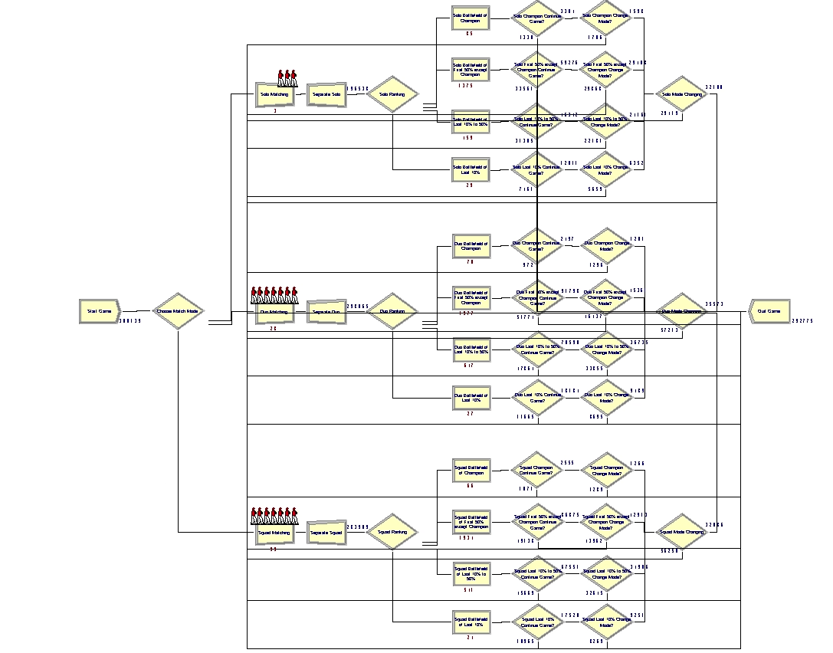
Simulation Verification by Arena
The procession of the Arena

Slide 15

Simulation Verification by Arena
Arena Simulation Software
Arena is a discrete event simulation and automation software developed by Systems Modeling and acquired by Rockwell Automation in 2000.

Slide 16
Simulation Verification by Arena
PlayerUnknown's Battlegrounds , a Battle Royale Game
PlayerUnknown's Battlegrounds (PUBG) is an online multiplayer battle royale game developed and published by PUBG Corporation, a subsidiary of South Korean video game company Bluehole.
What is a battle royale game? For example, in PlayerUnknown’s Battlegrounds, games are played between many individual players, pairs of two players or a number of small squads of 4 players. In each match, the goal is to be the last player or team standing by eliminating all other opponents.

Slide 17
Simulation Verification by Arena
Principles Followed when built the model:
Satisfying the result of the questionnaire survey
Using the same theory as the programming model
Referring to some actual data provided by the game’s company

Slide 18
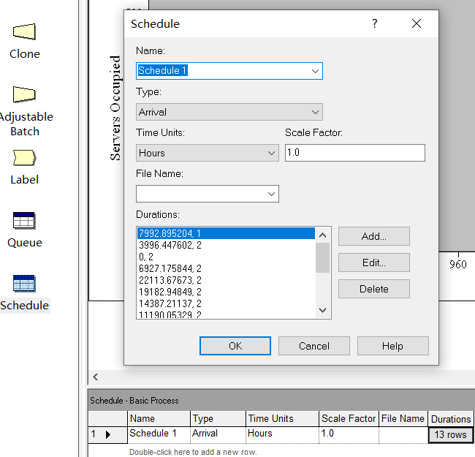
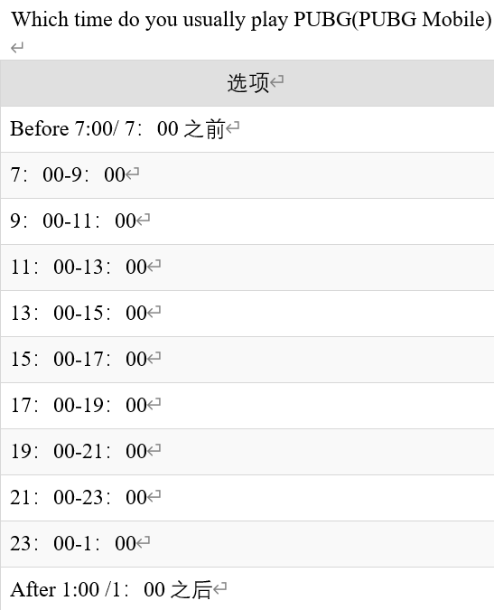
Simulation Verification by Arena
The procession of the Arena
For the arrival of the game, we need to generate Non-Stationary Processes to make the arrivals follow Non-Homogeneous Poisson Process (NHPP).

Slide 19
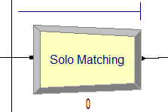
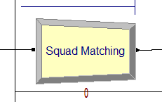
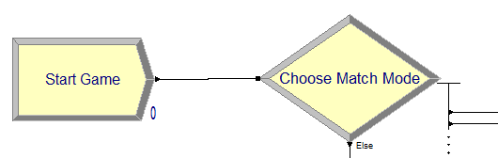
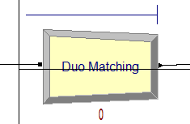
Simulation Verification by Arena
The procession of the Arena
Next, the players would choose 1 of 3 game mode: Solo, Duo and Squad (to play individually or in a team of 2 or 4 members). The probabilities of their selection has been obtained by input analysis.

Slide 20
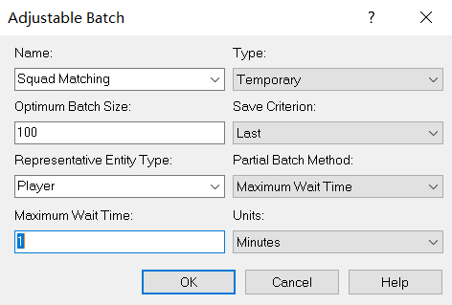
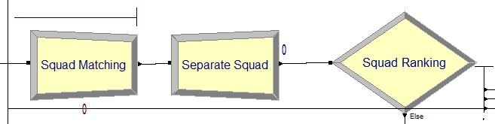

Simulation Verification by Arena
The procession of the Arena
For every mode, the matching rule is to wait up to 60s or 100 players. This is a G/G/∞ model.

Slide 21
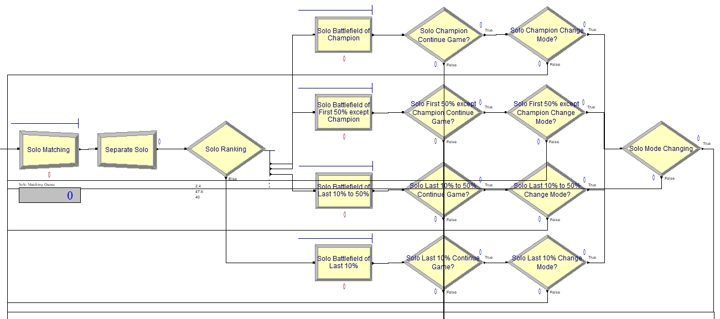
Simulation Verification by Arena
The procession of the Arena
In the questionnaire, we divided players into 4 groups, to know their preferences about whether to continue the game or change the game mode of the next match, according to their ranking in one game they just played.
Champion: Top 1
Almost Win: Top 50% except the champion
Half: Ranked 50% to 90%
Die Soon: Last 10%

Slide 22
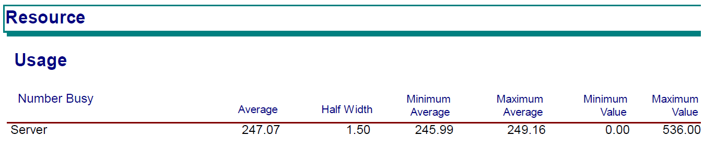
Simulation Verification by Arena
Arena was used to verify the results of the programming part and output analysis and further optimization of the original simulation analysis.

Slide 23
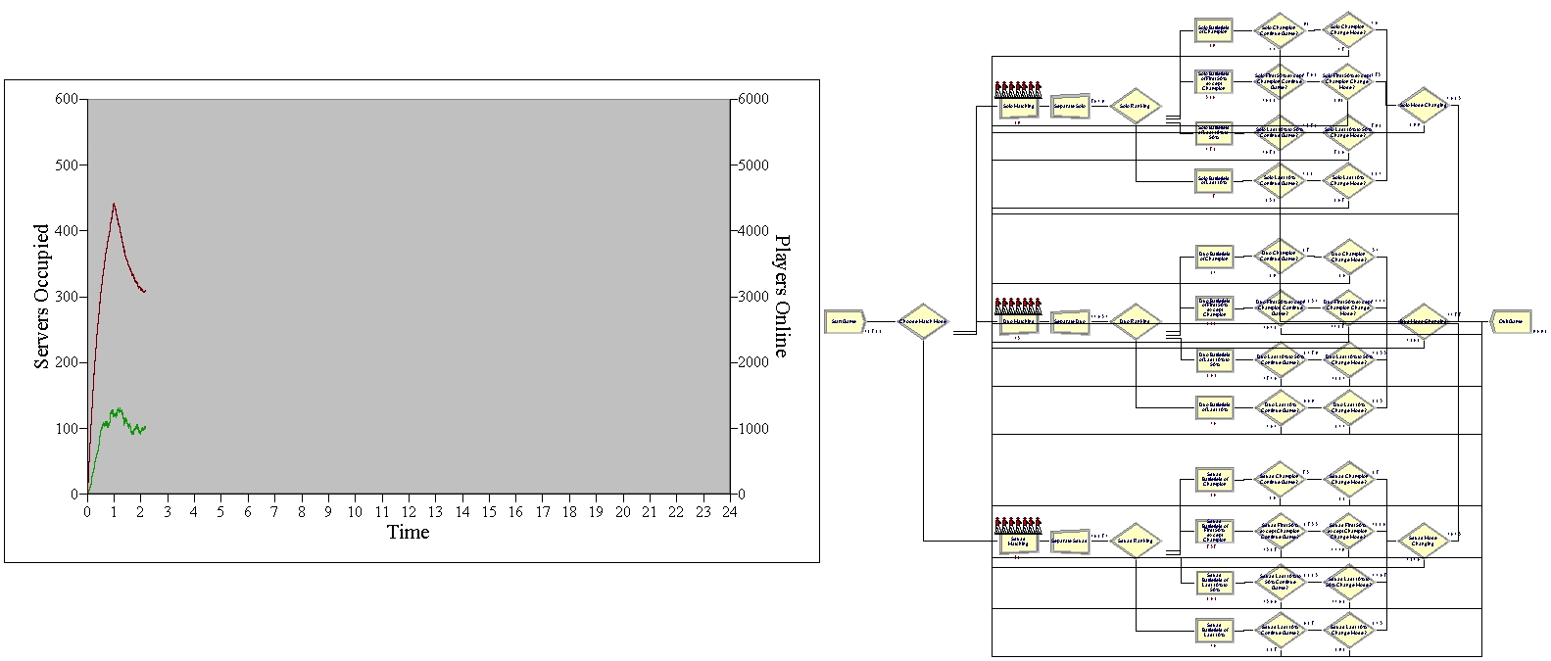
Simulation Verification by Arena
A line chart of it and the number of players online could be drawn.

Slide 24
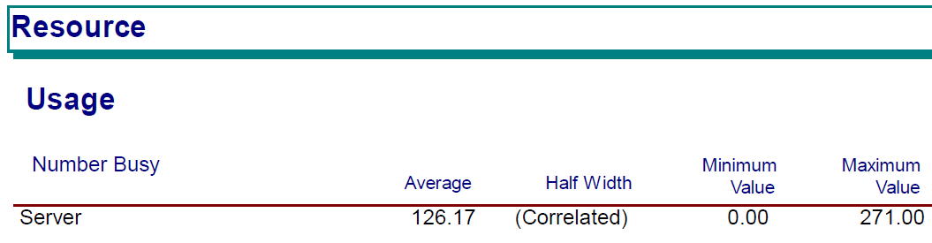
Simulation Verification by Arena
We also verified the result in the programming to change the number of players in one match from 100 to 200. The result is also similar to what we had from the programming model..

Slide 25
Optimization
The questionnaire survey investigated 335 samples, obtained the specific game data of each player, and adjusted the parameters of the system.
By adjusting the duration of the game and other parameters, we can see whether we can reduce the number of servers and relieve the pressure on the server
The original simulation system was further optimized through Arena.

Slide 26


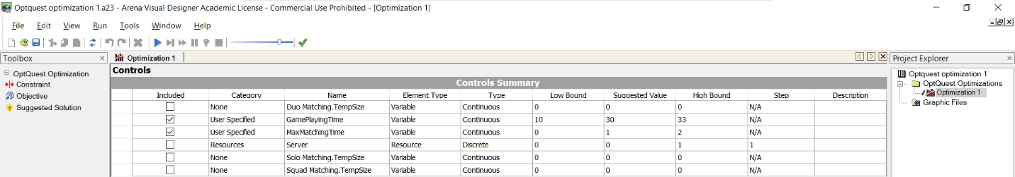
Optimization
Optimization could also be done by Arena.
We could do Optimization using a Trial-and-Error approach by changing some parameters and drawing the charts manually.
We could also use OptQuest to achieve optimization using the automatic search approach. In this way, some of our parameters need to be set as decision variables.

Slide 27
THANKS FOR YOUR WATCHING

